Slide 1
11 – Supervised Segmentation
Dave Eargle – CU Boulder

Slide 2
Supervised Segmentation
How can we segment the population into groups that differ from each with respect to some quantity of interest?
Informative attributes
Find knowable attributes that correlate with the target of interest
Increase accuracy
Alleviate computational problems
E.g., tree induction

Slide 3
Supervised Segmentation
How can we judge whether a variable contains important information about the target variable?
How much?

Slide 4
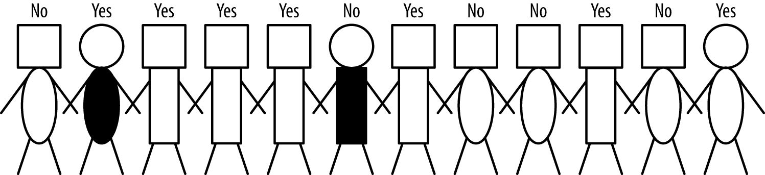
Selecting Informative Attributes
Objective: Based on customer attributes, partition the customers into subgroups that are less impure – with respect to the class (i.e., such that in each group as many instances as possible belong to the same class)
Is this a nice person?
Target
Head shape
Body Shape
Body Color

Slide 5
Which attribute is most informative on whether a person is nice?
Target: is this a nice person?
Which is most predictive?
Target
Head shape
Body Shape
Body Color

Slide 6
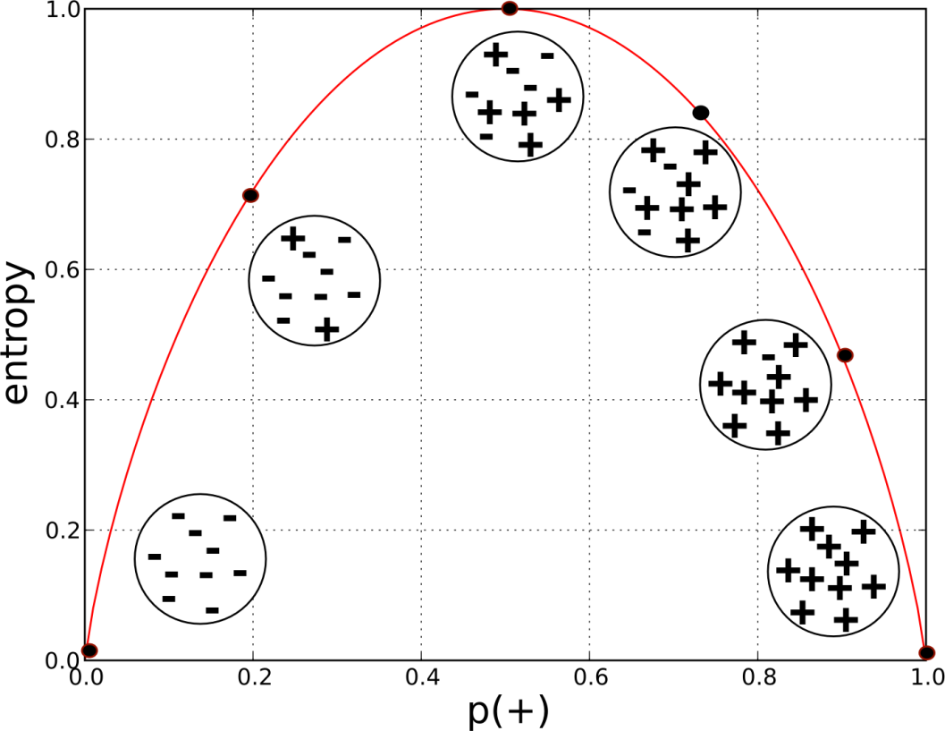
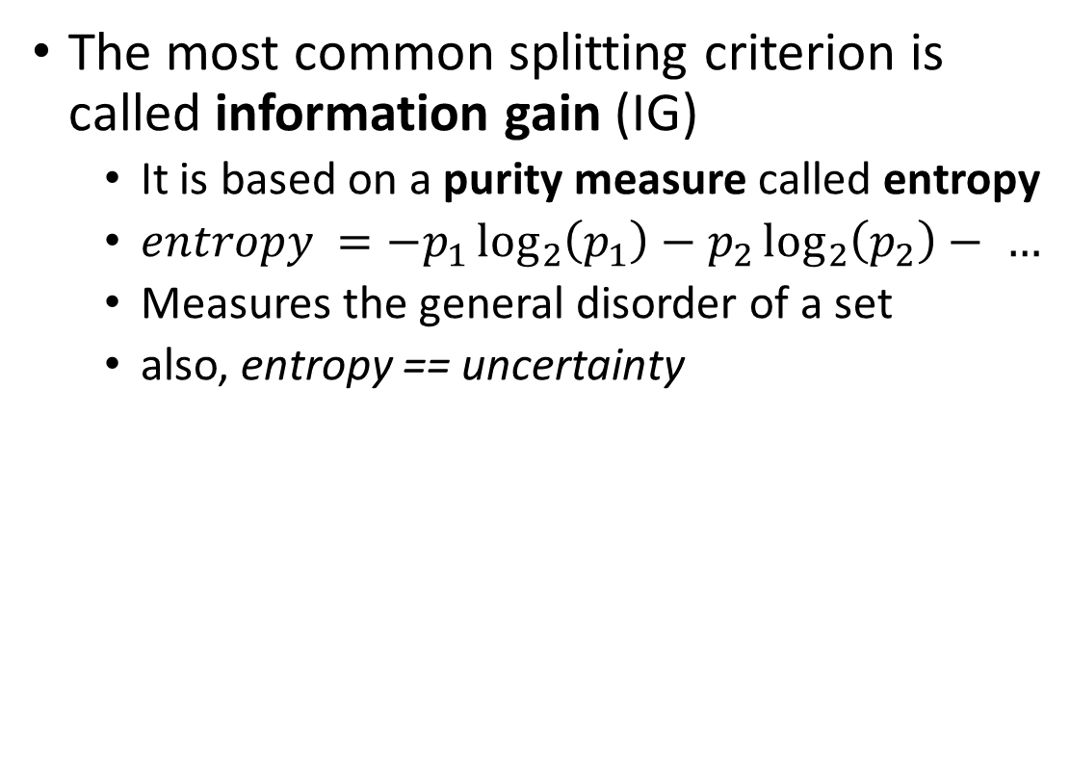
Selecting Informative Attributes
The most common splitting criterion is called information gain (IG)
It is based on a purity measure called entropy
$entropy =−p_{1}\log_{2}\left(p_{1}\right)−p_{2}\log_{2}\left(p_{2}\right)− …$
Measures the general disorder of a set
also, entropy == uncertainty

Slide 7
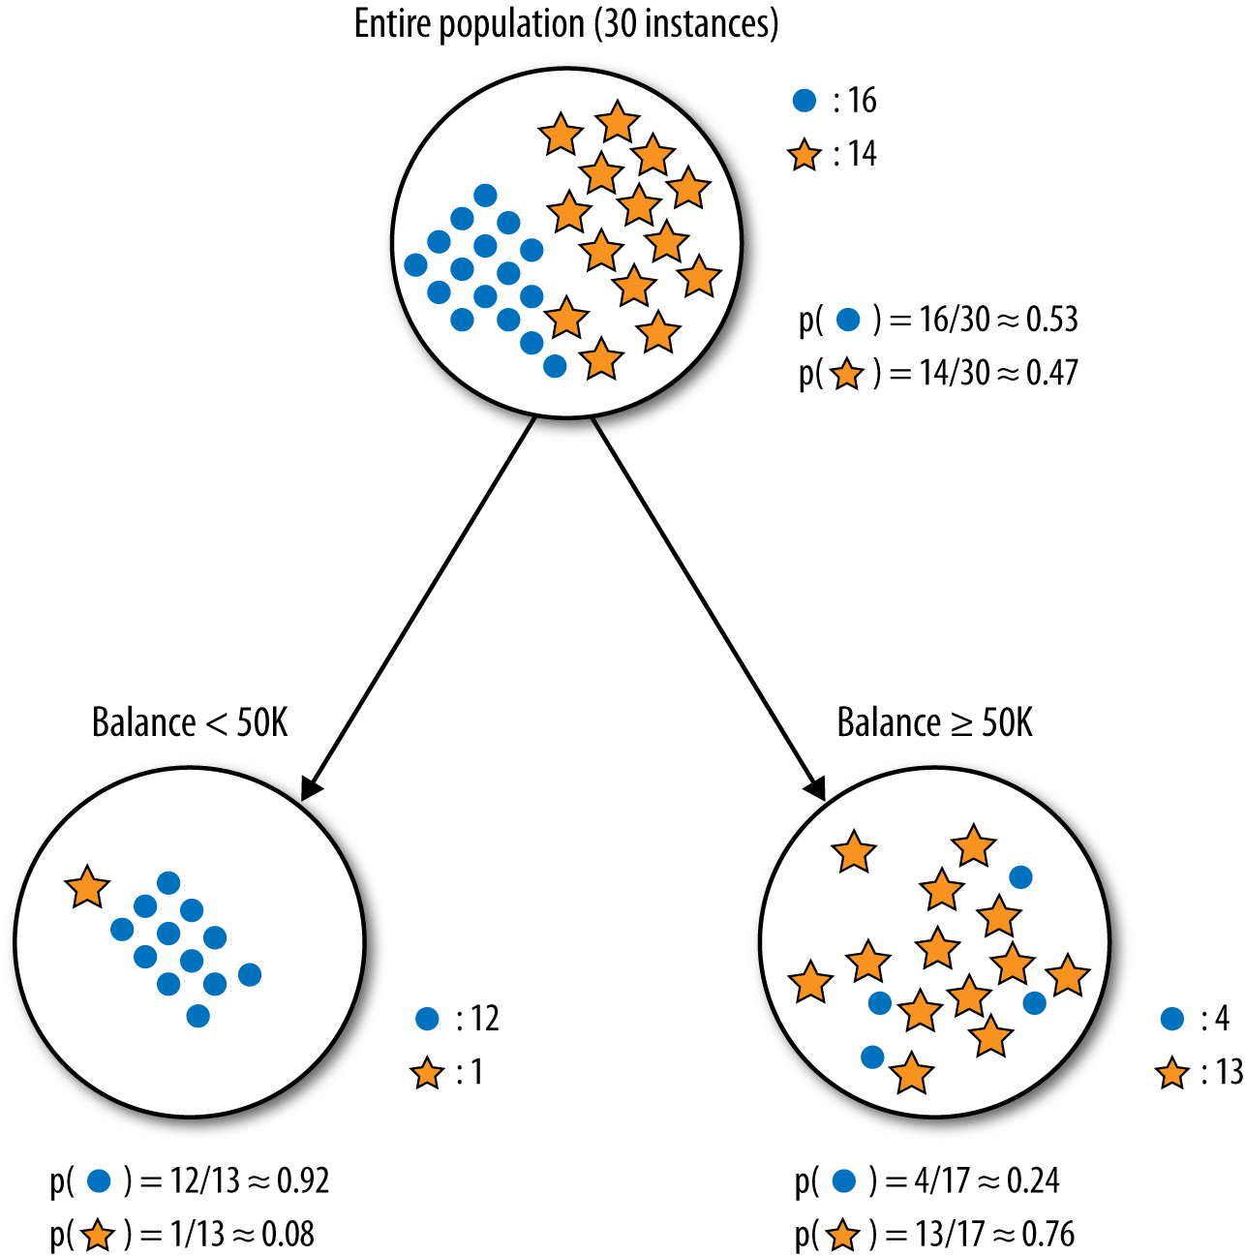

Information Gain
Information gain measures the change in entropy due to any amount of new information being added

Slide 8
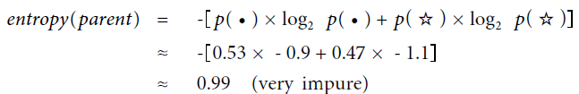
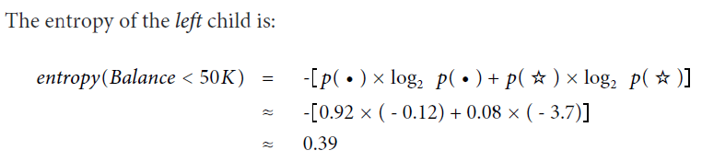
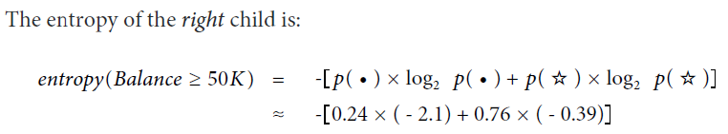

Information Gain
$$≈ 0.79$$

Slide 9
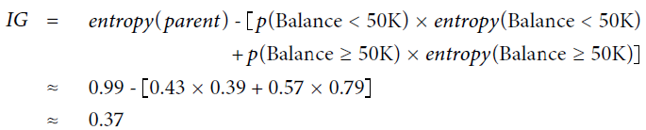
Information Gain
p(c1) = proportion of points in child 1
= 13 / 30
= .43
p(c2) = proportion of points in child 2
= 17 / 30
= .57

Slide 10
So, again, which attribute to pick?
Which is most predictive?
Target
Head shape
Body Shape
Body Color

Slide 11
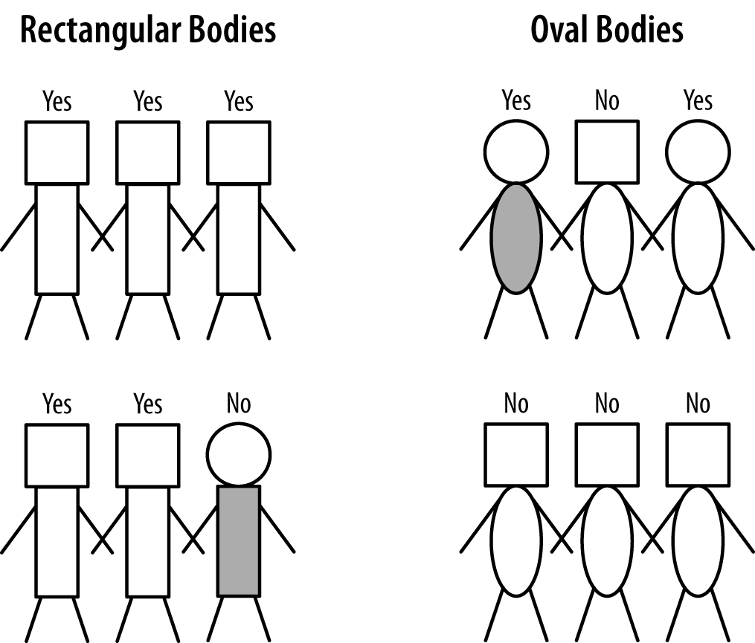
Body shape has highest information gain (just trust me)

Slide 12
Attribute Selection
Reasons for selecting only a subset of attributes:
Better insights and business understanding
Better explanations and more tractable models
Reduced cost for data collection
Faster predictions
Better predictions!
Over-fitting (will talk more about this later...)
and also determining the most informative attributes..

Slide 13
Example: Attribution Selection with Information Gain
This dataset includes descriptions of hypothetical samples corresponding to 23 species of gilled mushrooms in the Agaricus and Lepiota Family
Each species is identified as definitely edible, definitely poisonous, or of unknown edibility and not recommended
This latter class was combined with the poisonous one
The Guide clearly states that there is no simple rule for determining the edibility of a mushroom; no rule like “leaflets three, let it be” for Poisonous Oak and Ivy
IS THAT A CHALLENGE

Slide 14
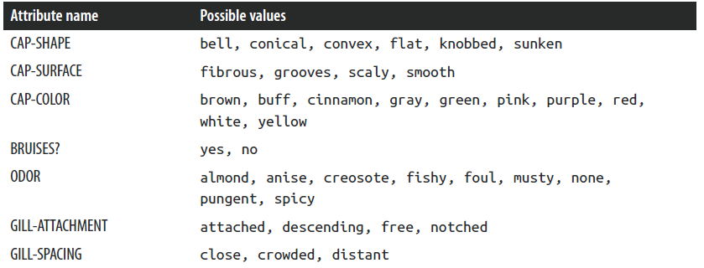

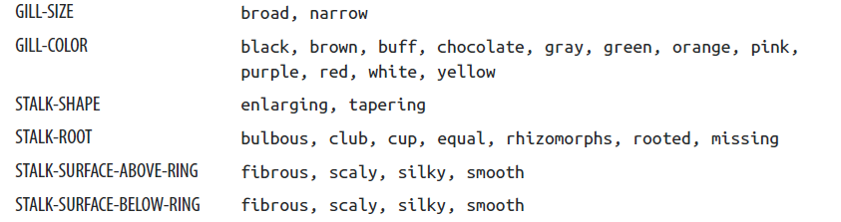
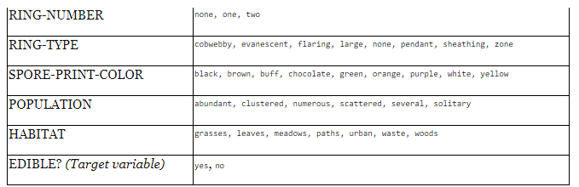
Example: Attribution Selection with Information Gain
Let’s examine information gain if we split on either GILL-COLOR or ODOR

Slide 15
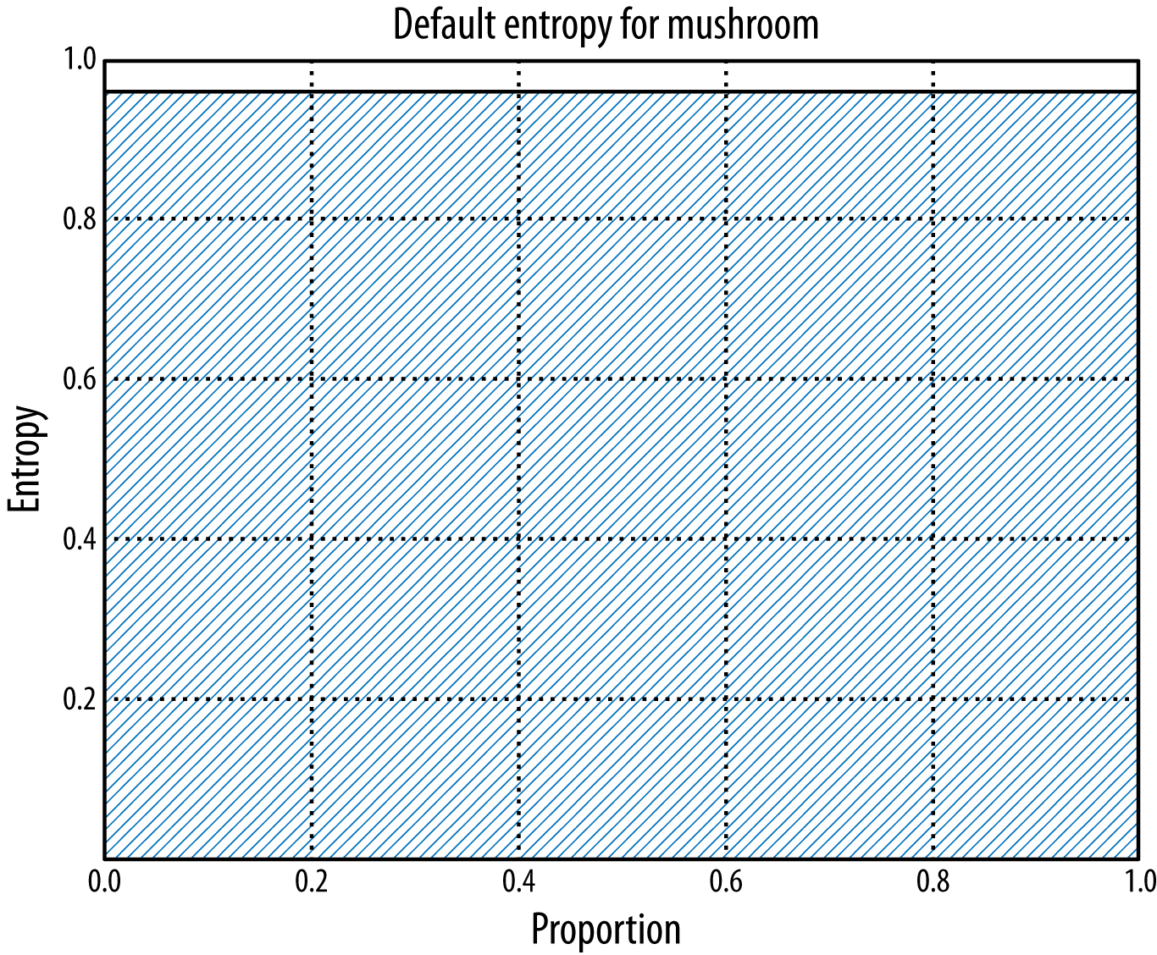
Example: Attribution Selection with Information Gain
Total entropy is the shaded area

Slide 16
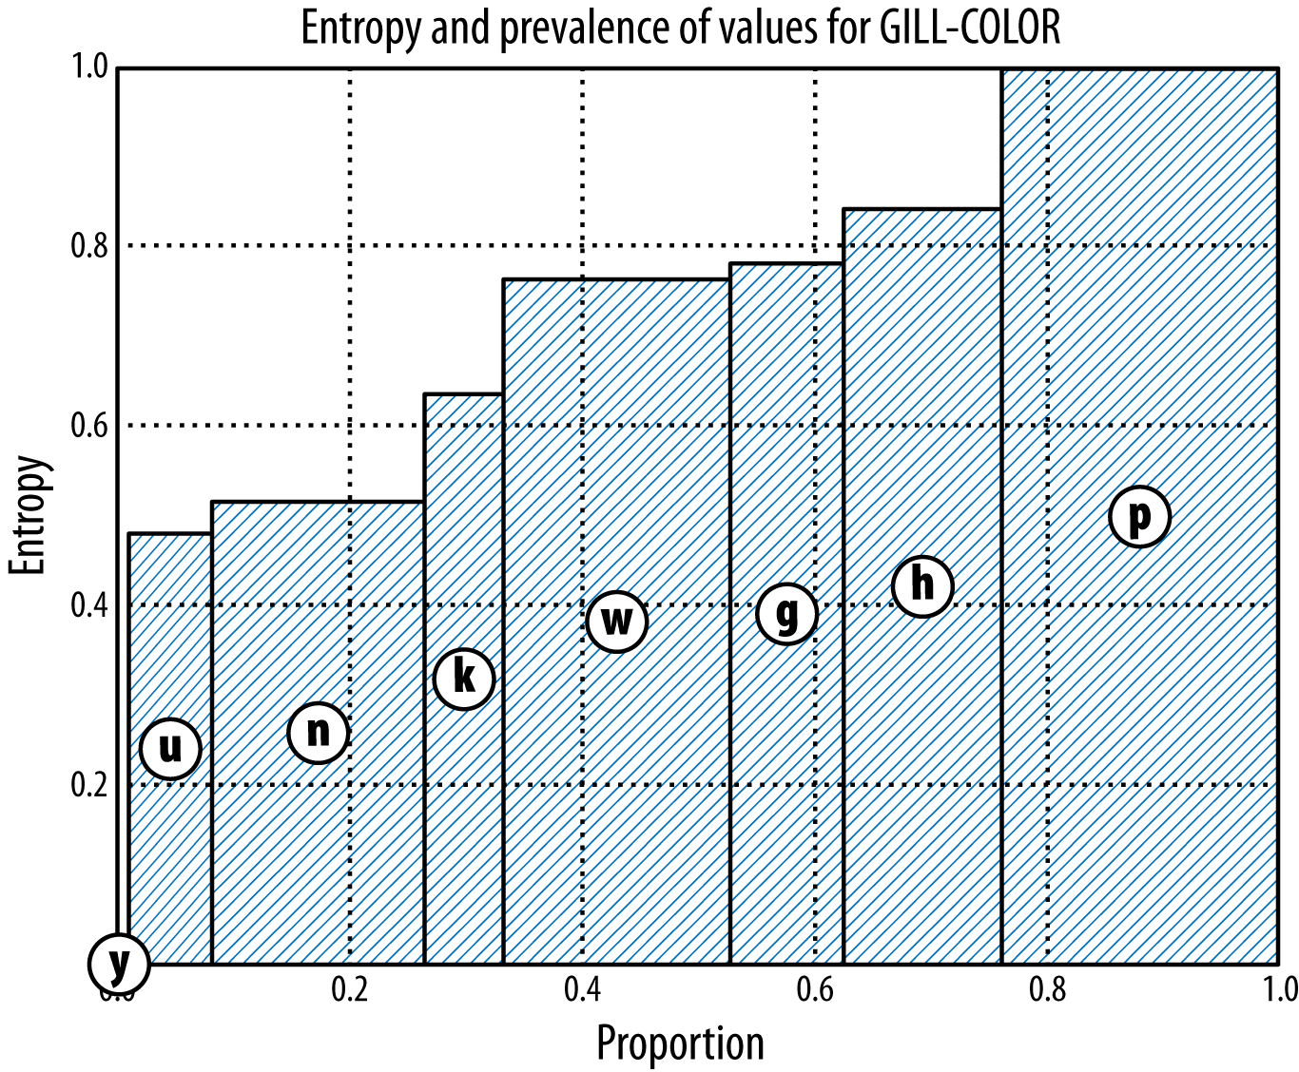
Example: Attribution Selection with Information Gain – GILL-COLOR
Total entropy is the shaded area. How much did entropy drop?
Width of bars is overall proportion for that child

Slide 17
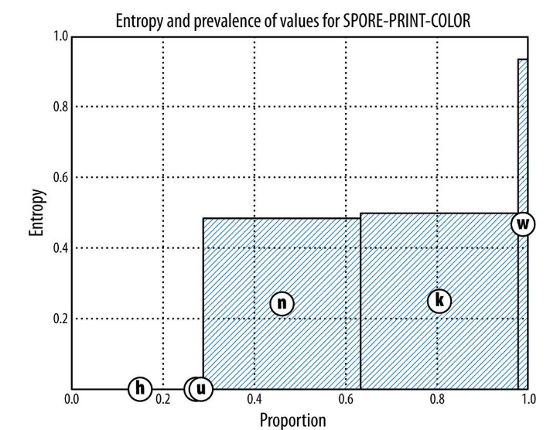

Slide 18
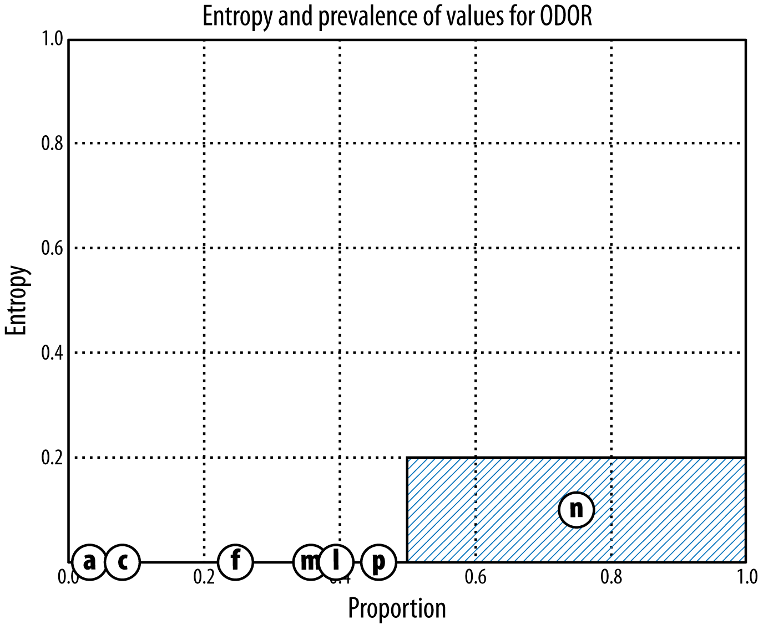
Example: Attribution Selection with Information Gain -- ODOR

Slide 19
Multivariate Supervised Segmentation
If we select the single variable that gives the most information gain, we create a very simple segmentation
If we select multiple attributes each giving some information gain, how do we put them together?

Slide 20
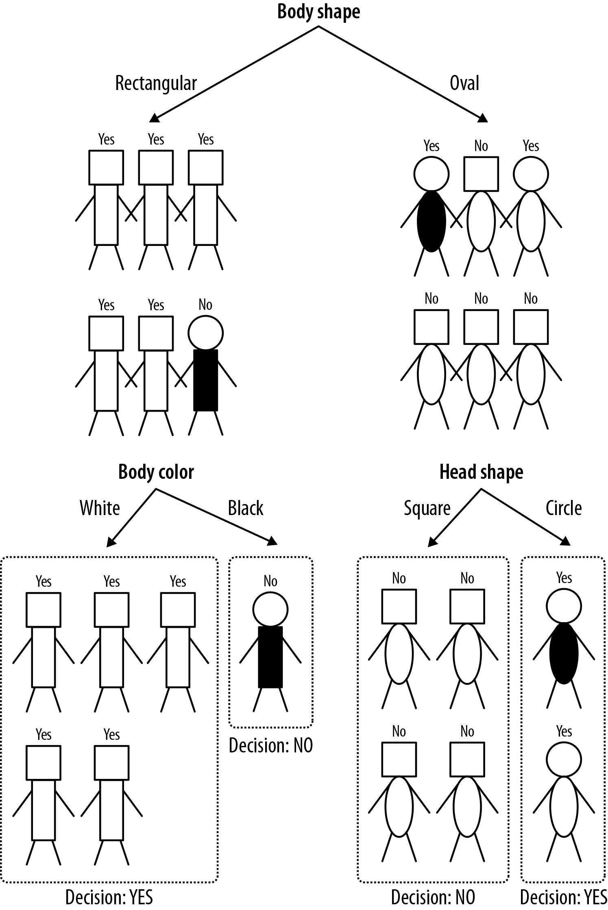
We have reduced the entropy to 0!
All children are pure!

Slide 21
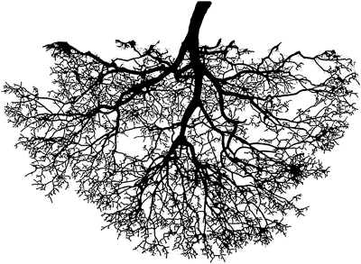
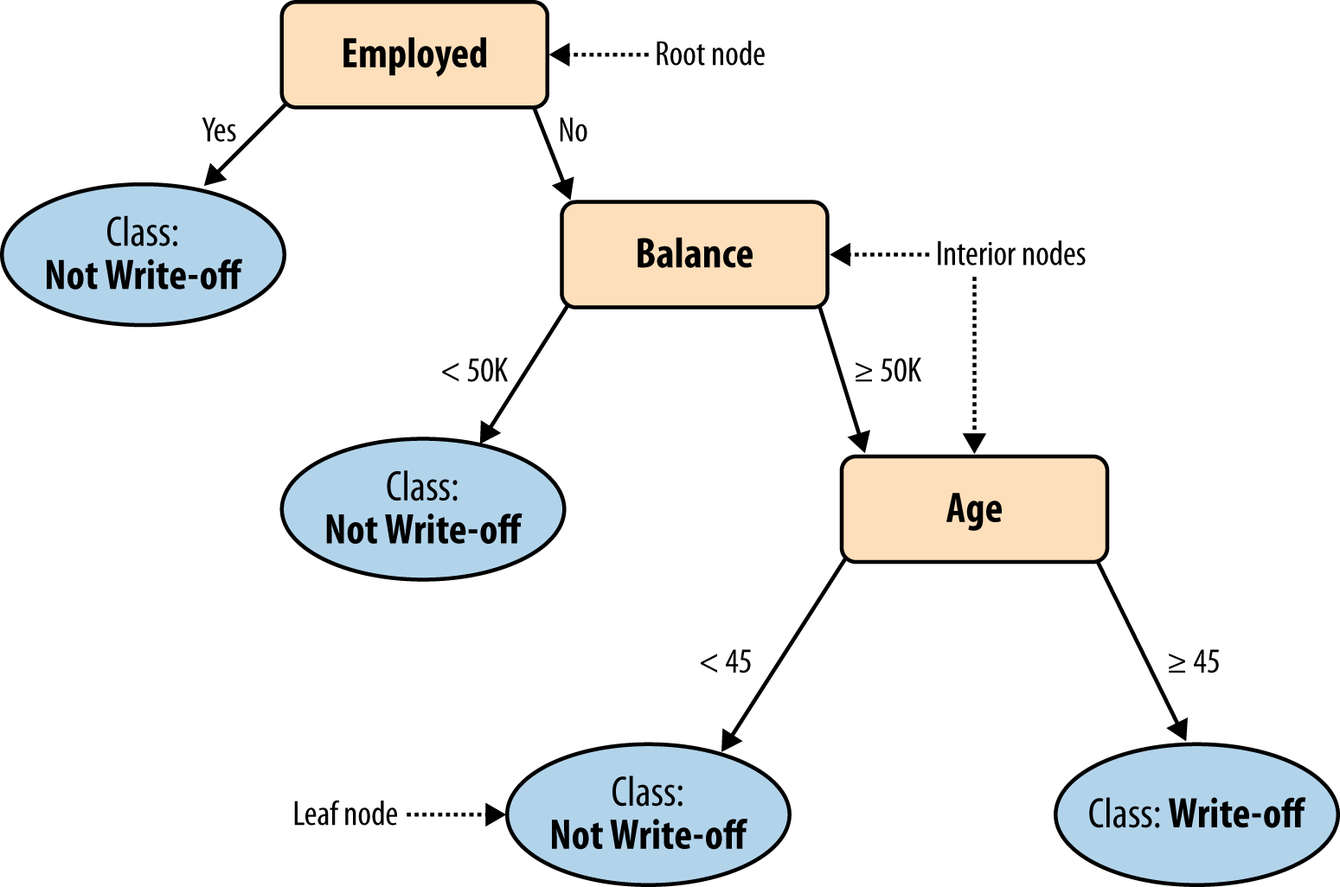
Tree-Structured Models

Slide 22
Tree-Structured Models
Classify ‘John Doe’
Balance=115K, Employed=No, and Age=40

Slide 23
Tree-Structured Models: “Rules”
No two parents share descendants
There are no cycles
The branches always “point downwards”
Every example always ends up at a leaf node with some specific class determination
Probability estimation trees, regression trees (to be continued...)

Slide 24
Tree Induction
How do we create a classification tree from data?
divide-and-conquer approach
take each data subset and recursively apply attribute selection to find the best attribute to partition it
When do we stop?
The nodes are pure,
there are no more variables, or
even earlier (over-fitting – to be continued..)

Slide 25
Why trees?
Decision trees (DTs), or classification trees, are one of the most popular data mining tools
(along with linear and logistic regression)
They are:
Easy to understand
Easy to implement
Easy to use
Computationally cheap
Almost all data mining packages include DTs
They have advantages for model comprehensibility, which is important for:
model evaluation
communication to non-DM-savvy stakeholders

Slide 26
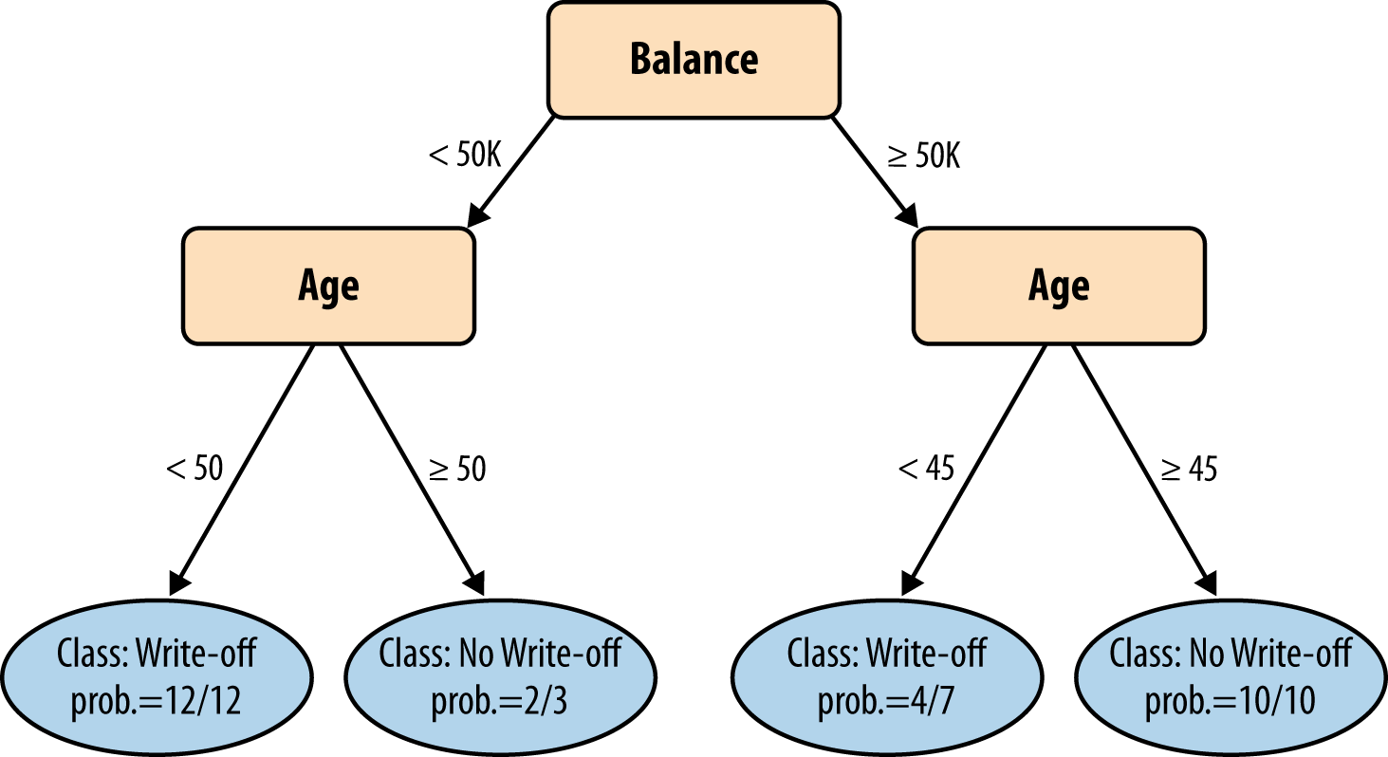
Visualizing Segmentations

Slide 27
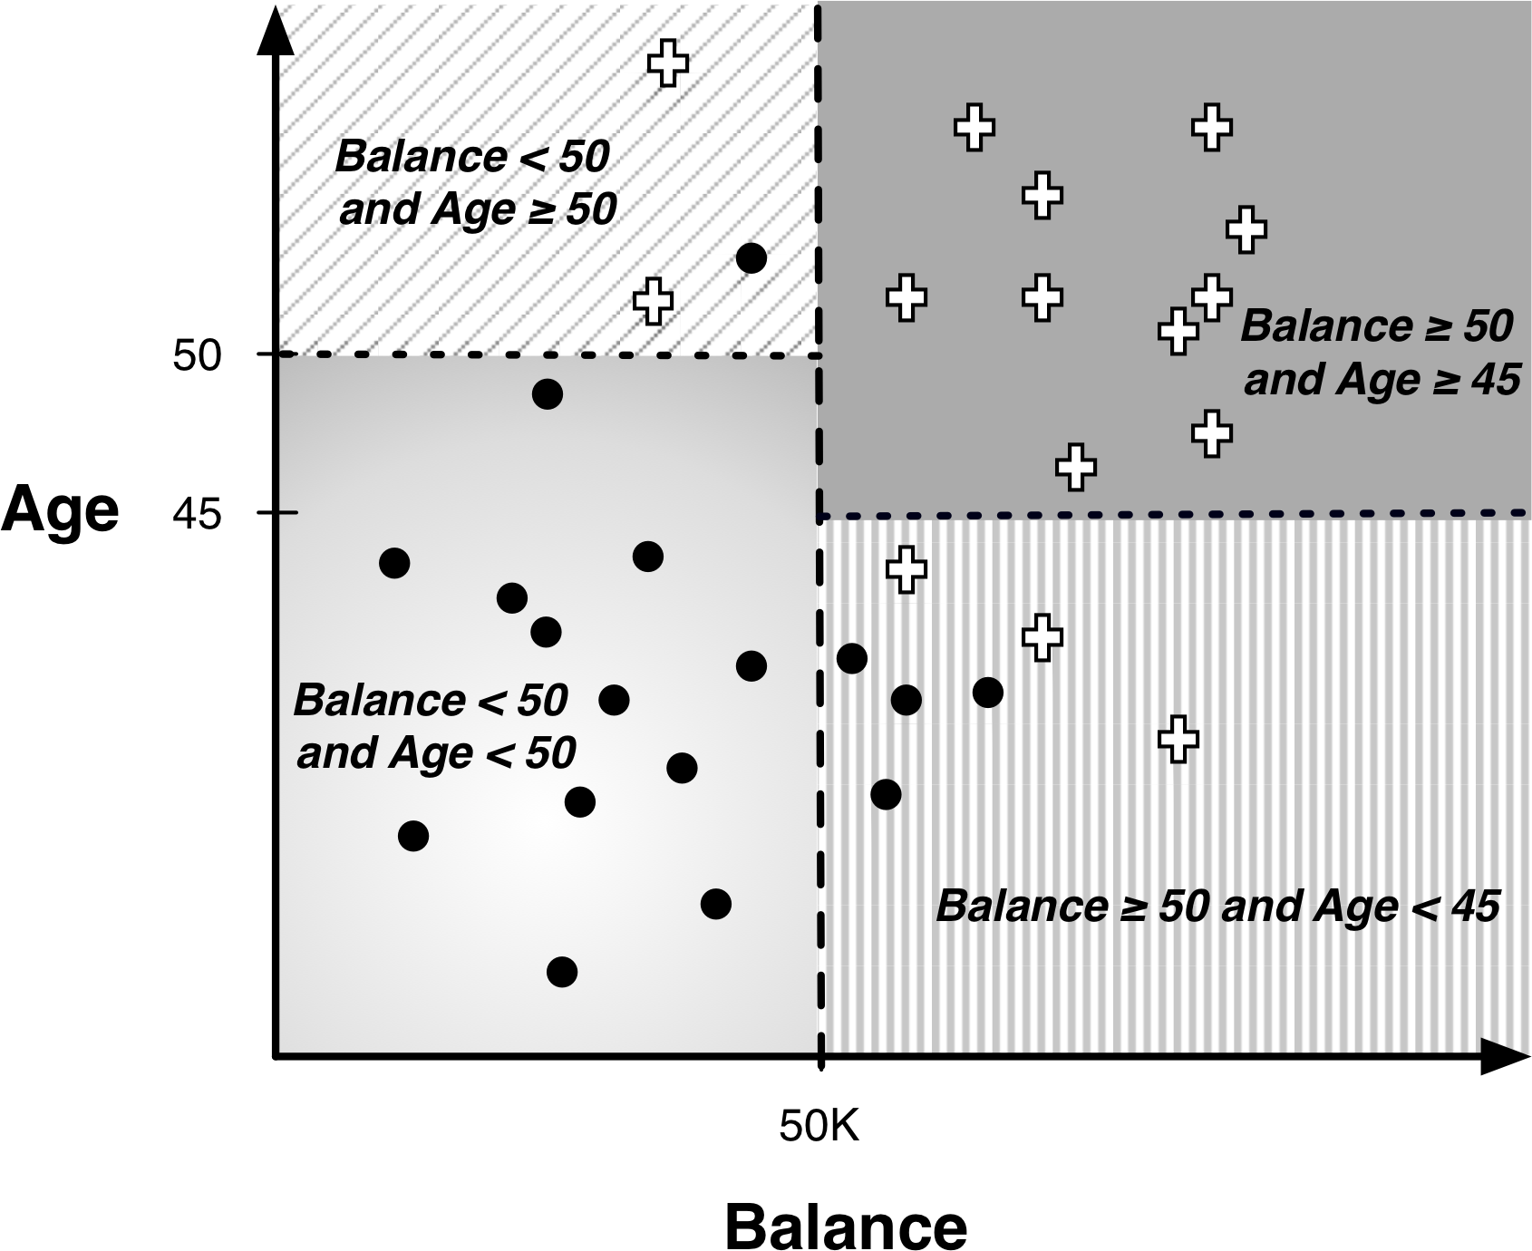
Visualizing Segmentations
+ = not write-off
* = write-off

Slide 28
Geometric interpretation of a model
Split over income
Pattern:
IF Balance >= 50K & Age > 45
THEN Default = ‘no’
ELSE Default = ‘yes’
Age
45
Split over age
50K
Income
Default
Not default

Slide 29
Geometric interpretation of a model
What alternatives are there to partitioning this way?
Age
Income
Default
Not default

Slide 30
Geometric interpretation of a model
What alternatives are there to partitioning this way?
“True” boundary may not be closely approximated by a linear boundary!
Cannot do this with supervised segmentation. Need a linear discriminant (next class…)
Age
45
50K
Income
Default
Not default

Slide 31
Trees as Sets of Rules
The classification tree is equivalent to this rule set
Each rule consists of the attribute tests along the path connected with AND

Slide 32
Trees as Sets of Rules
The classification tree is equivalent to this rule set
Each rule consists of the attribute tests along the path connected with AND
IF (Employed = Yes) THEN Class=`No Write-off`
IF (Employed = No) AND (Balance < 50k) THEN Class=`No Write-off`
IF (Employed = No) AND (Balance ≥ 50k) AND (Age < 45) THEN Class=`No Write-off`
IF (Employed = No) AND (Balance ≥ 50k) AND (Age ≥ 45) THEN Class=`Write-off`

Slide 33
What are we predicting?
Classification tree
Split over income
Income
Age
<50K
>=50K
NO
Age
45
Split over age
<45
>=45
?
NO
YES
50K
Income
Did not buy life insurance
Bought life insurance
Interested in LI? = NO

Slide 34
What are we predicting?
Classification tree
Split over income
Income
Age
<50K
>=50K
p(LI)=0.15
Age
45
Split over age
<45
>=45
?
p(LI)=0.43
p(LI)=0.83
50K
Income
Did not buy life insurance
Bought life insurance
Interested in LI? = 3/7

Slide 35
MegaTelCo: Predicting Customer Churn
Why would MegaTelCo want an estimate of the probability that a customer will leave the company within 90 days of contract expiration rather than simply predicting whether a person will leave the company within that time?
You might want to rank customers their probability of leaving

Slide 36
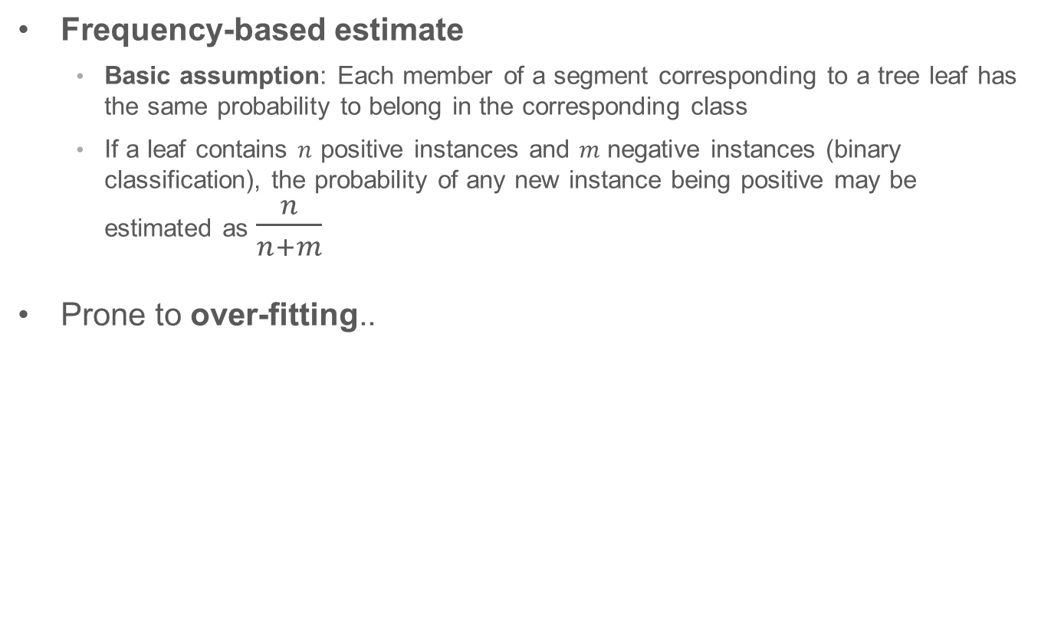
From Classification Trees to Probability Estimation Trees
Frequency-based estimate
Basic assumption: Each member of a segment corresponding to a tree leaf has the same probability to belong in the corresponding class
If a leaf contains $n$ positive instances and $m$ negative instances (binary classification), the probability of any new instance being positive may be estimated as $\frac{n}{n+m}$
Prone to over-fitting..

Slide 37
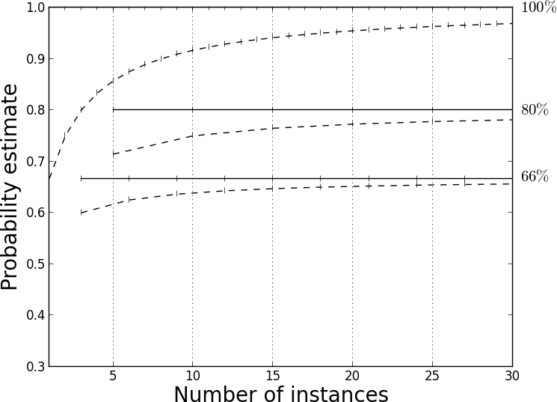

Laplace Correction
$p\left(c\right)=\frac{n+1}{n+m+2}$,
where $n$ is the number of examples in the leaf belonging to class $c$, and m is the number of examples not belonging to class $c$
Which would you trust more?
A prediction of 90% that came out of a child node with only 10 data points?
A prediction of 50% that came out of a child node with 10,000,000 data points?
Laplace correction penalizes predictions that come from child nodes with few datapoints.

Slide 38
The many faces of classification: Classification / Probability Estimation / Ranking
Classification Problem
Most general case: The target takes on discrete values that are NOT ordered
Most common: binary classification where the target is either 0 or 1
3 Different Solutions to Classification
Classifier model: Model predicts the same set of discrete value as the data had
In binary case: 0, 1
Ranking: Model predicts a score where a higher score indicates that the model think the example to be more likely to be in one class
Probability estimation: Model predicts a score between 0 and 1 that is meant to be the probability of being in that class

Slide 39
When to use each: Classification / Probability Estimation / Ranking
Increasing difficulty
Classification
Ranking
Probability
Classifier: (don’t do it)
Ranking:
business context determines the number of actions (“how far down the list”)
cost/benefit is constant, unknown, or difficult to calculate
Probability:
you can always rank / classify if you have probabilities!
cost/benefit is not constant across examples and known relatively precisely
You can always go backwards, but you can’t go forwards

Slide 40
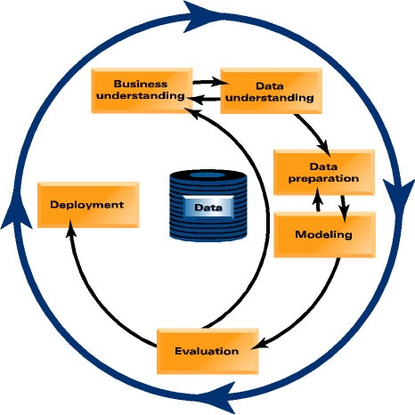
Let’s focus back in on actually mining the data..
Which customers should TelCo target with a special offer, prior to contract expiration?

Slide 41
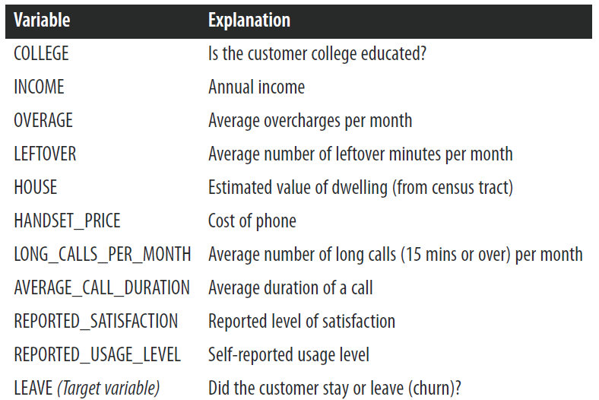
MegaTelCo: Predicting Churn with Tree Induction

Slide 42
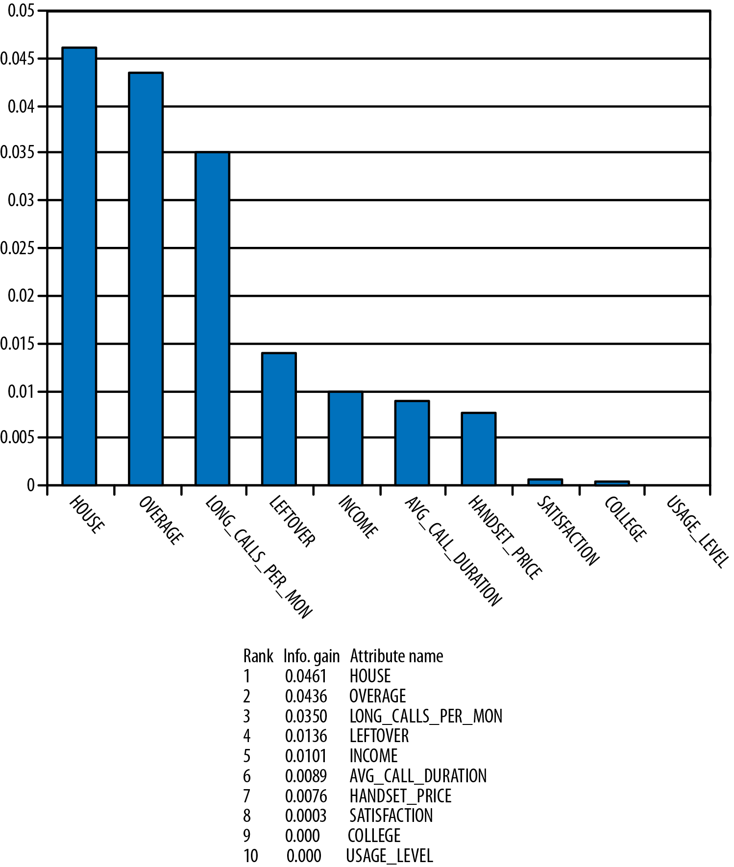
MegaTelCo: Predicting Churn with Tree Induction

Slide 43
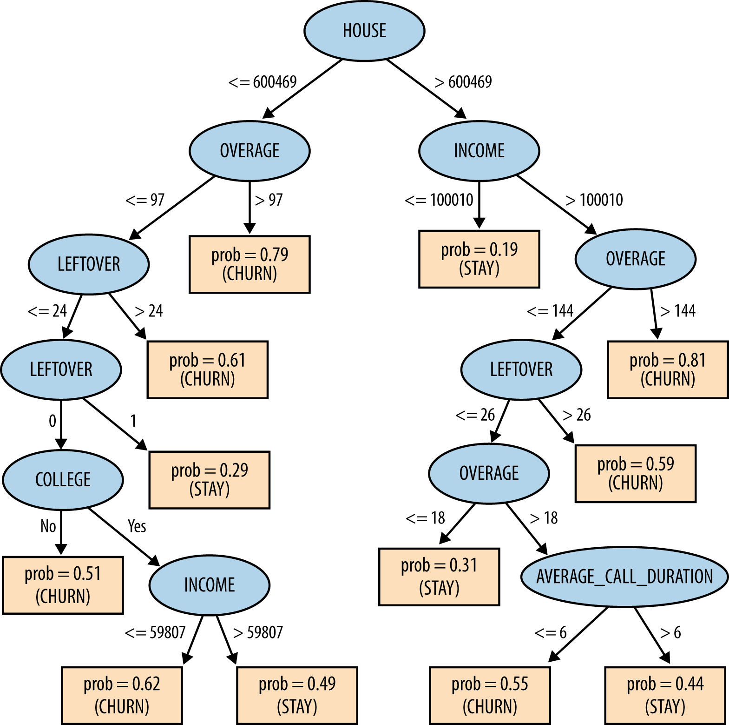
MegaTelCo: Predicting Churn with Tree Induction

Slide 44
Let’s do it!
Alteryx > Help > Sample Workflows > Predictive Analytics > 6 Decision Tree
Copy-paste the decision tree node
for the new one, “Customize” > “Hyper Parameters” > Check “Set Complexity Parameter”, set it to 0
add all browses
`Browse` the “I” node, > `New Window` > `Tree`
Hover over some of the nodes

Slide 45
Many figures in this slide deck from Provost, F., & Fawcett, T. (2013). Data science for business: what you need to know about data mining and data-analytic thinking. Sebastopol, Calif.: O'Reilly.

